Slide 1
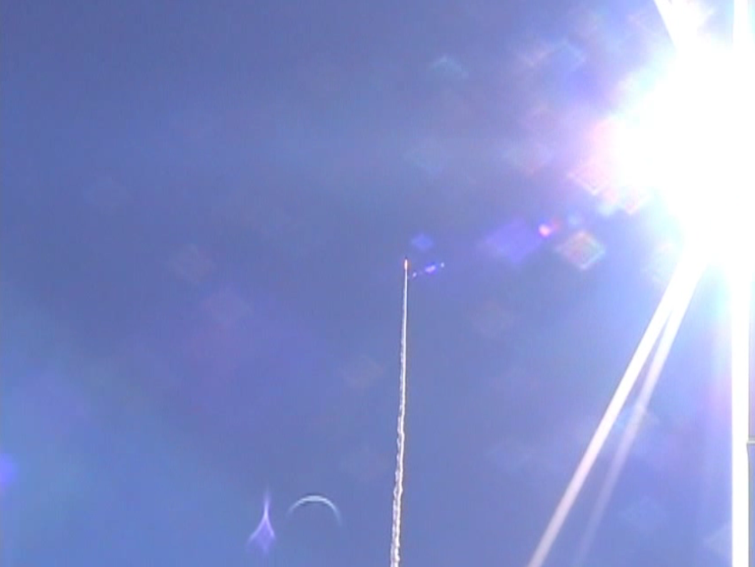
Rocket Tracks

Slide 2
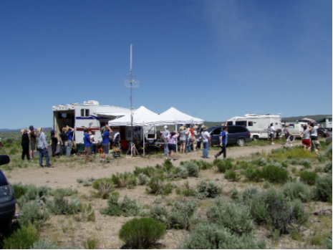
Background:
  Part of Portland State Aerospace Society (PSAS)
  10 years of rocket launches
  “Poster Child” for PSU engineering

Slide 3
Recent Work:
  Becoming recognized in amateur and “new” commercial rocketry for recent work
    Return to flight 2009
    Roll control 2010
    Decoupled fins 2010
    Guidance 2011 - 2012

Slide 4
Recent Work:
  Recognition largely due to media
    YouTube videos of launches
    PSAS Website
    Social media
      NASA Tweetup

Slide 5
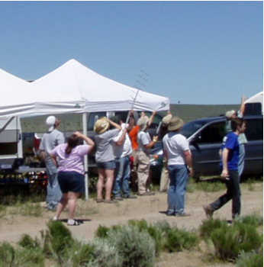
Problem:
  PSAS rockets fly as high as 5000 meters (over 3 miles!)
  Tracking with antennas is difficult
  Tracking with cameras nearly impossible!

Slide 6
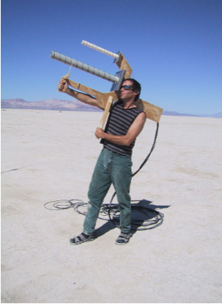
Problem:
  As altitudes increases, visual tracking is not possible.
  In 10 years of rocket launches, no one has filmed the parachutes opening at apogee

Slide 7
Solution:
  Automated tracking stations: “Rocket Track”
    Antennas
    Video Cameras
    Long lens SLR cameras

Slide 8
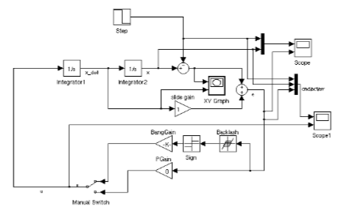
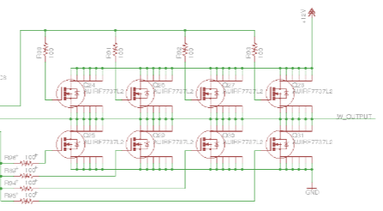
Solution:
  Project involves
    Mechanical Engineering
    Electrical Engineering
    Control Theory
    Welding and Machining

Slide 9
Funds:
  High level budget:
    Structural Steel: $150
    Drive Motors: 2 x $50
    Drives and controls: $300
    Bearings and hubs: $180
    Drive belts and pulleys: $200

Slide 10
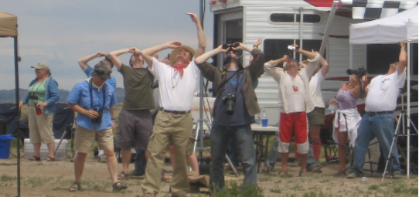
Questions?

